Slide 1
CHAP I. Introduction
Numerical Simulation
of
Turbulent Flows - LES

Slide 2
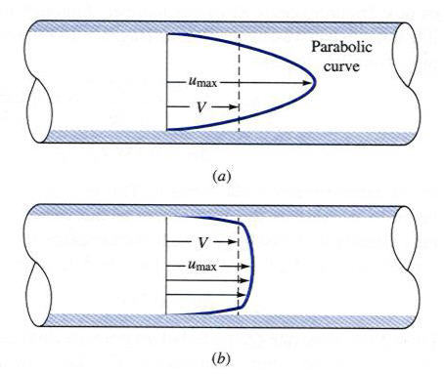
Turbulence
Laminar Flow
Turbulent Flow
I. Introduction

Slide 3
Techniques for Turbulence Simulation
  Governing Equations of Fluid Mechanics
  Mass conservation
  Momentum conservation
  Species transport
  Energy conservation
Navier-Stokes equations
Scalar transport equations
  Turbulence information
  The non-linear governing PDEs contains the whole information on turbulent fields.
  Accept solutions fluctuating over a wide range of scales when some parameters (e.g. Re number) exceeds a threshold.
I. Introduction

Slide 4
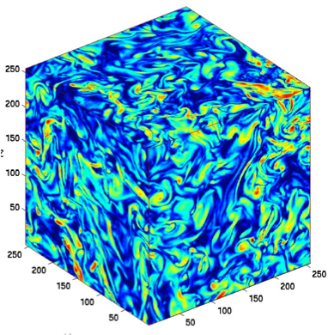
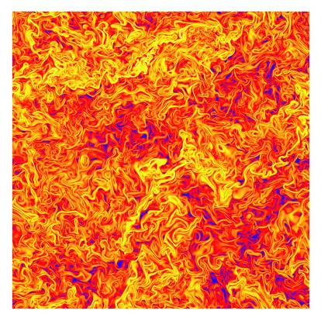
Techniques for Turbulence Simulation
  DNS (Direct Numerical Simulations)
  No modeling
  Resolution of all scales
  Prohibitive computational costs
  Moderate Re number and simple geometries
I. Introduction

Slide 5
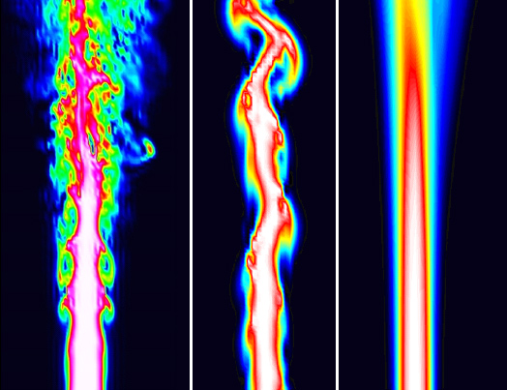
Techniques for Turbulence Simulation
  Filtering (LES) and Averaging (RANS)
  Removing high frequency fluctuations
  Turbulent
  Flame
Experiment
LES
RANS
I. Introduction

Slide 6
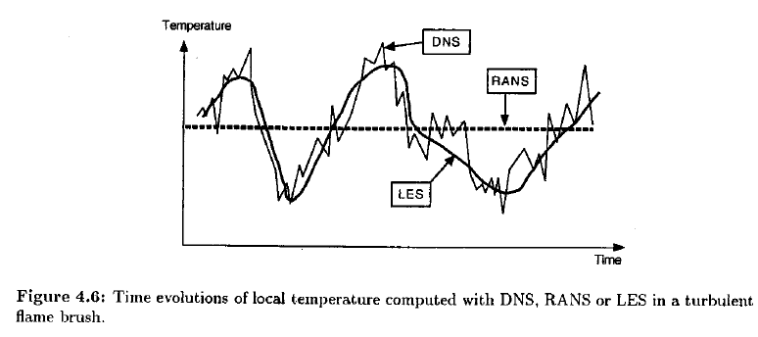
Techniques for Turbulence Simulation
  Filtering and Averaging
  Physical space
I. Introduction

Slide 7
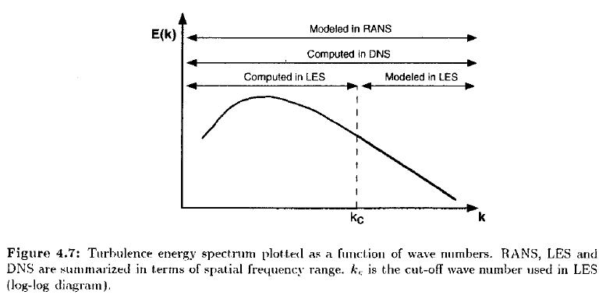
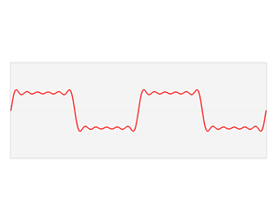
Techniques for Turbulence Simulation
  Filtering and Averaging
  Spectral space
I. Introduction

Slide 8
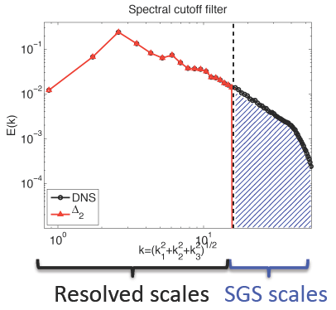
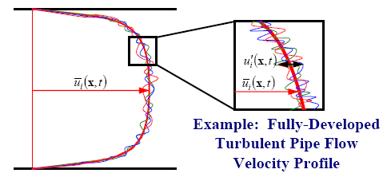
Techniques for Turbulence Simulation
  Closure problem (origin)
Filtering
Averaging
  + non-linearity
  = closure problem
I. Introduction

Slide 9
Techniques for Turbulence Simulation
  Closure problem (governing equations)
  Mass:
  Momentum (i =1, 2, 3):
  Species (N species with k=1,..,N):
  Total enthalpy (ht = h + u_{i}u_{i}/2):
Reynolds stresses
I. Introduction

Slide 10
Techniques for Turbulence Simulation
  Closure problem (modeling)
  RANS (Reynolds-Averaged Navier-Stokes equations) [stationary]
    Eddy-viscosity models (Gradient diffusion assumption)
      Zero-equation models
      One-equation models
      Two-equation models (k-ε, k-ω, …)
      Three-equation models
      Four-equation models (v²-f)
      Non-linear models
    RSM (Reynolds Stress (transport) Model)
  LES (Large Eddy Simulation) [stationary and instationary]
  PDF (Probability Density Function) [combustion]
I. Introduction

Slide 11
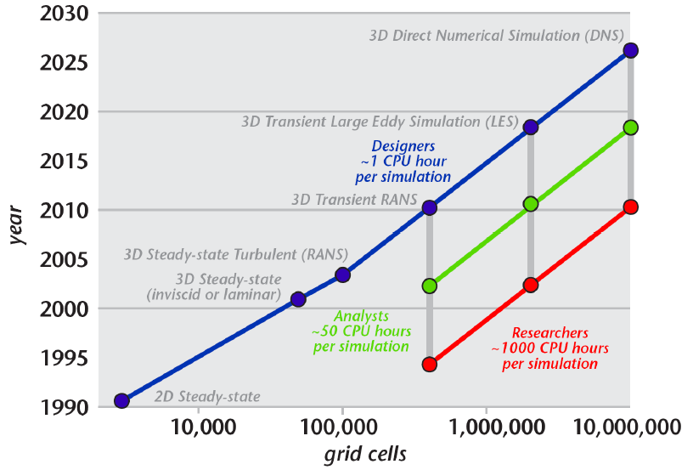
Techniques for Turbulence Simulation
  Closure problem (modeling)
  RANS
  LES
  PDF
DES (Detached Eddy Simulation)
FDF (Filtered Density Function)
I. Introduction

Slide 12
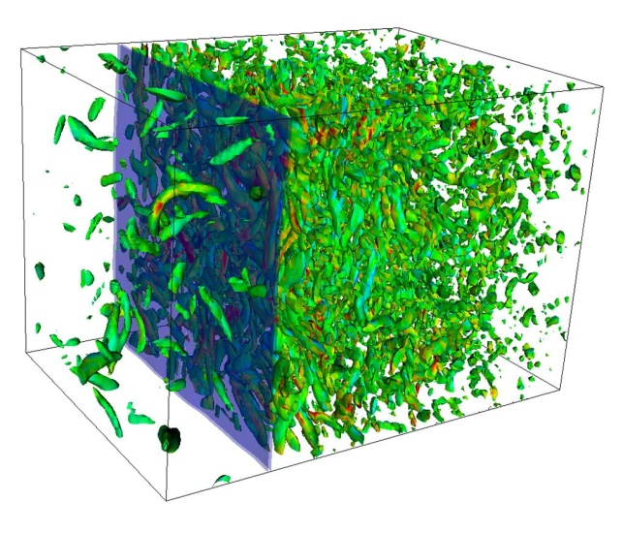
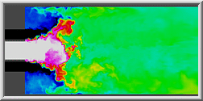
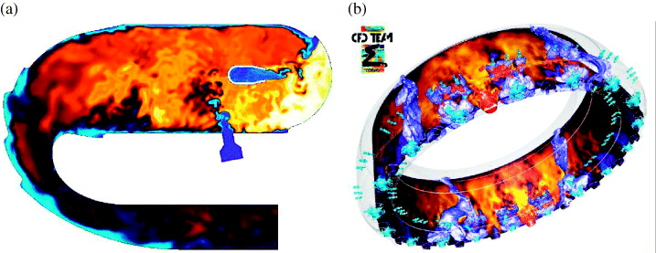
Current state of LES simulations
  From homogeneous shear flows
  To multi-phase flow combustion in complex geometries
I. Introduction

Slide 13
Course Outline
  Turbulence
  Governing Equations (Chap II)
  Mathematical tools for studying turbulence
    Statistical (Chap III) versus deterministic
    Physical space (Chap V) versus spectral space (Chap VI)
  Turbulence Simulation
  Overview of different models, esp. RANS (Chap VII)
  LES (Chap VIII)
  Introduction to PDF (Chap IX) *
I. Introduction

